Slide 1
Journée: Cloud Coffre Fort Numérique
26 Février 2015
“Digital Safe Client via HTML5 ”
Mayssa JEMEL
Ahmed SERHROUCHNI

Slide 2
Plan
HTML5: Web Revolution
HTML5: Local Storage APIs
Local Digital Safe
Conclusion

Slide 3
HTML5: Web Revolution
Notes:
3

Slide 4
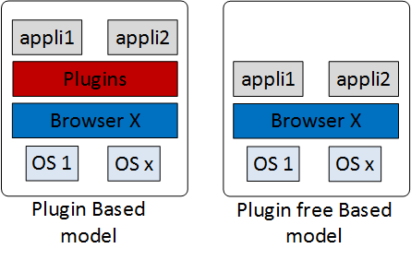
HTML5: Web Revolution
Standardized by:
W3C: World Wide Web Consortium
WHATWG: Web Hypertext Application Technology Working Group
Bypassing the proprietary environment
Reducing the gap between Web 2.0 services and underlying technologies
3

Slide 5
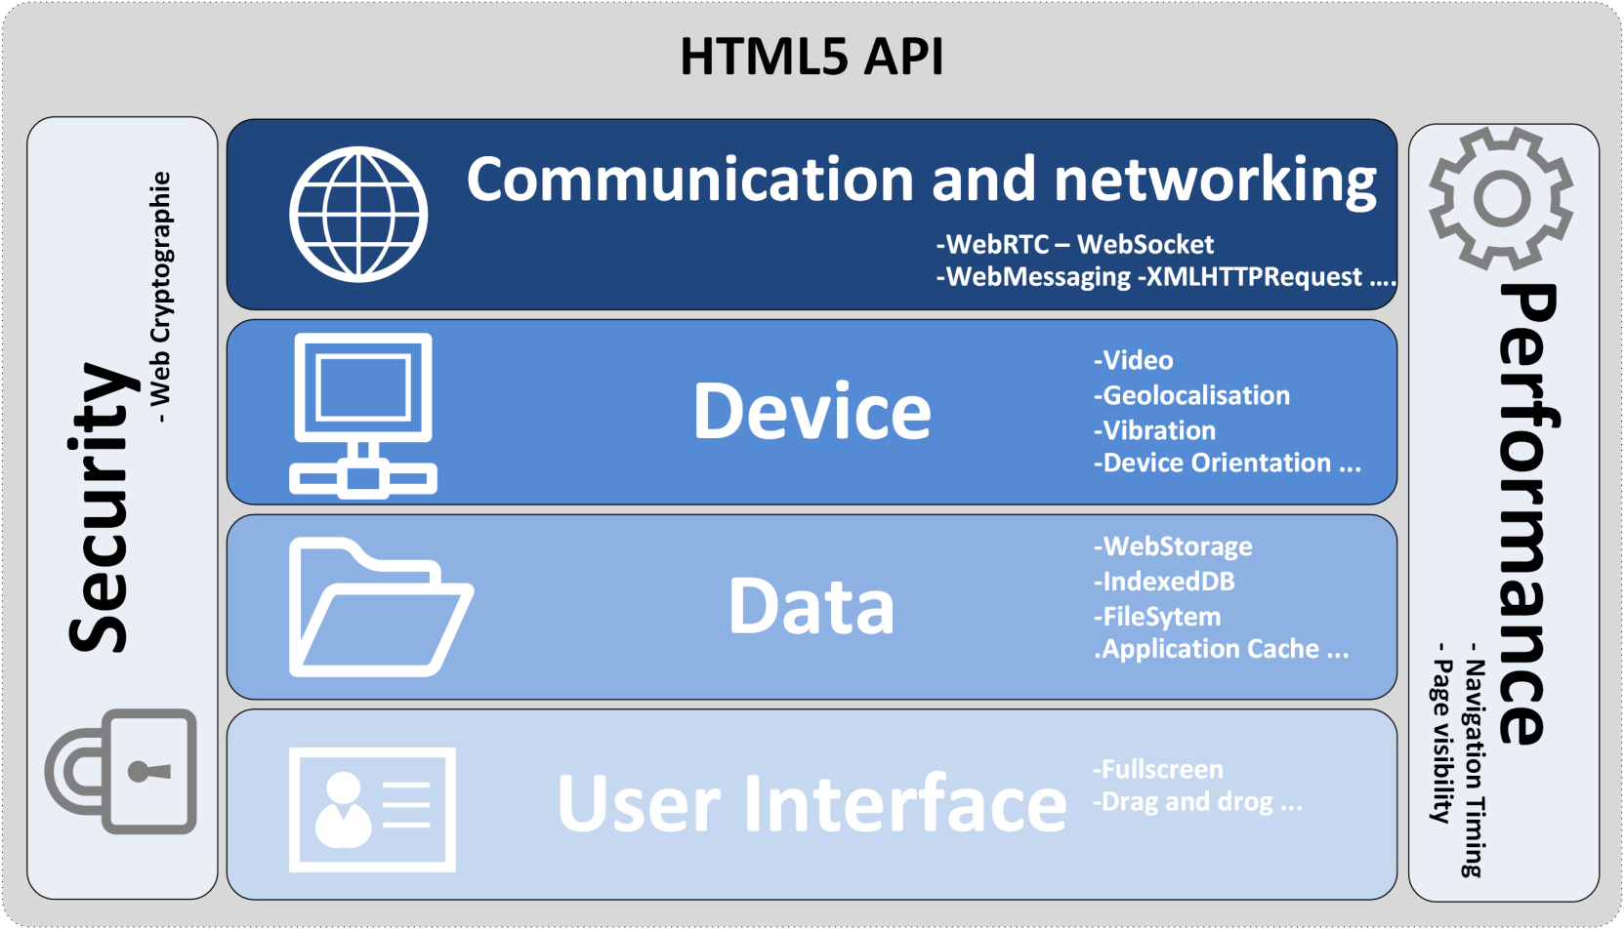
HTML5: APIs classification
4

Slide 6
HTML5: Local Storage APIs
Notes:
6

Slide 7
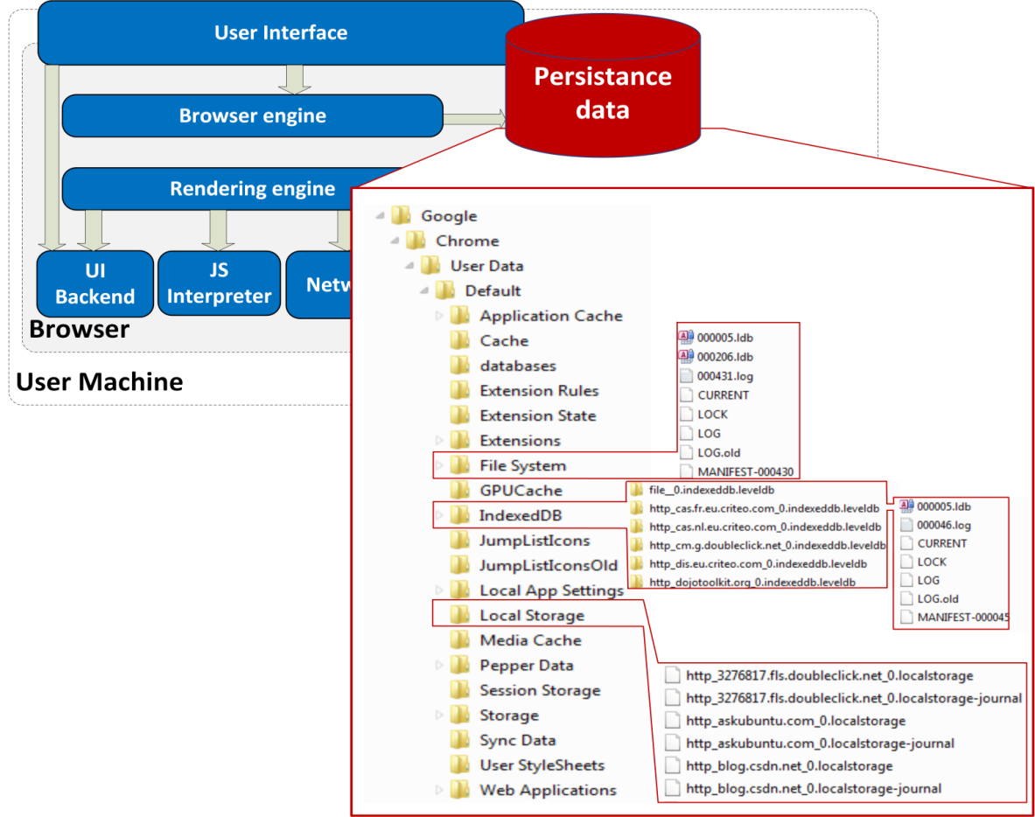
HTML5: Local Storage APIs
WebStorage API
Storing key/value pair data in the browser
Key
FileSystem API:
Simulating a virtual file system to enable web application managing files and folders
IndexedDB:
Replacing the relational databases. Storing data in an indexed database pair data in the browser
Browser’s architecture with the Local Data Storage
Indexed
5

Slide 8
HTML5: Local Storage APIs
WebStorage API
Storing key/value pair data in the browser
Key
Browser’s architecture with the Local Data Storage
6

Slide 9
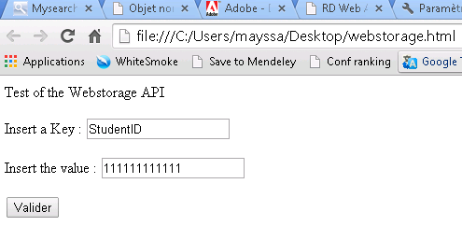
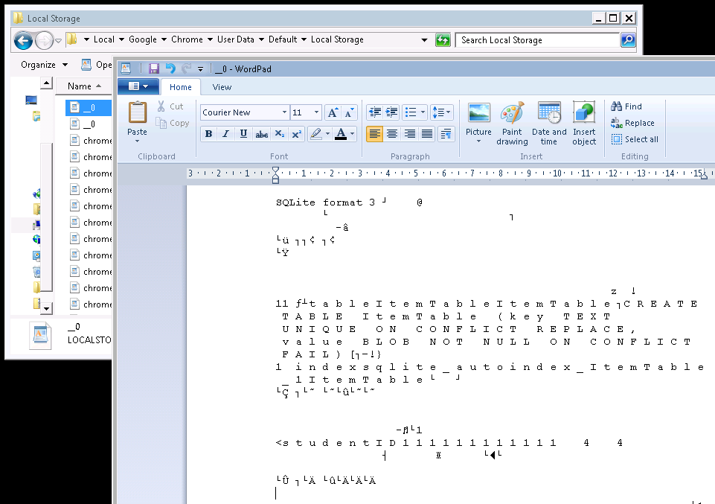
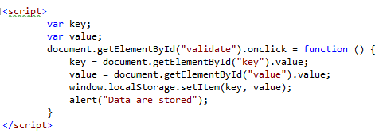
WebStorage API
Indexed
7

Slide 10
HTML5: Local Storage APIs
WebStorage API
Storing key/value pair data in the browser
Key
FileSystem API:
Simulating a virtual file system to enable web application managing files and folders
Browser’s architecture with the Local Data Storage
8

Slide 11
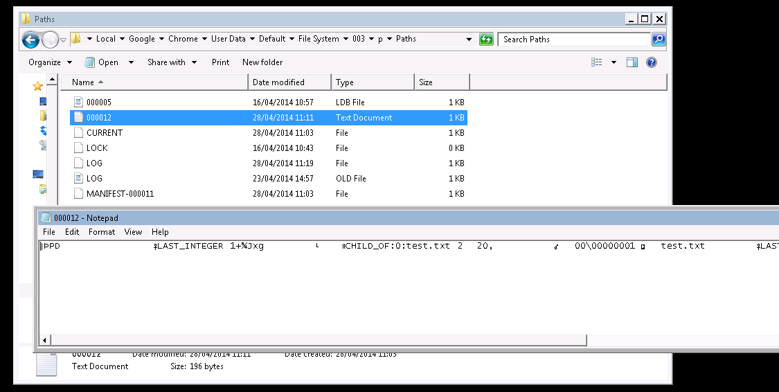
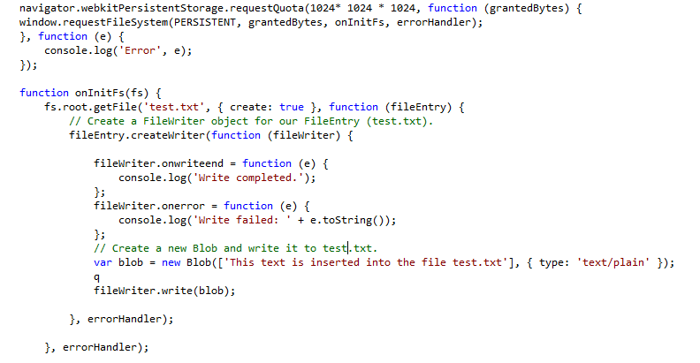
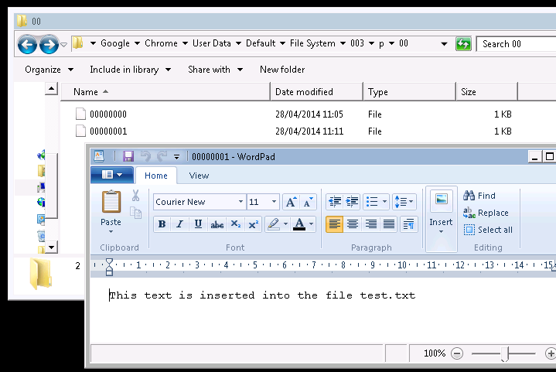
FileSystem API
9
Notes:
The different APIs of local Storage HTML5 APIs uses the SOP as the only form for data protection.
In this case every browser stores the data of every domain in a separate location. Fig 1
Analyzing in depth these APIs, we find that the data are exposed to many vulnerabilities.
Our contribution is to attribute to each subscribed user his separate storage space where
his data are stored encrypted. We called this space a Personal digital safe

Slide 12
HTML5: Local Storage APIs
WebStorage API
Storing key/value pair data in the browser
Key
FileSystem API:
Simulating a virtual file system to enable web application managing files and folders
IndexedDB:
Replacing the relational databases. Storing data in an indexed database pair data in the browser
Browser’s architecture with the Local Data Storage
Indexed
10

Slide 13
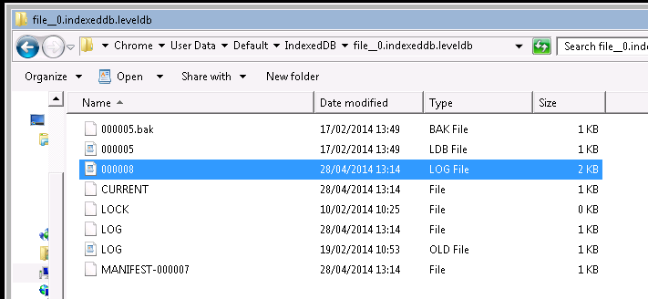
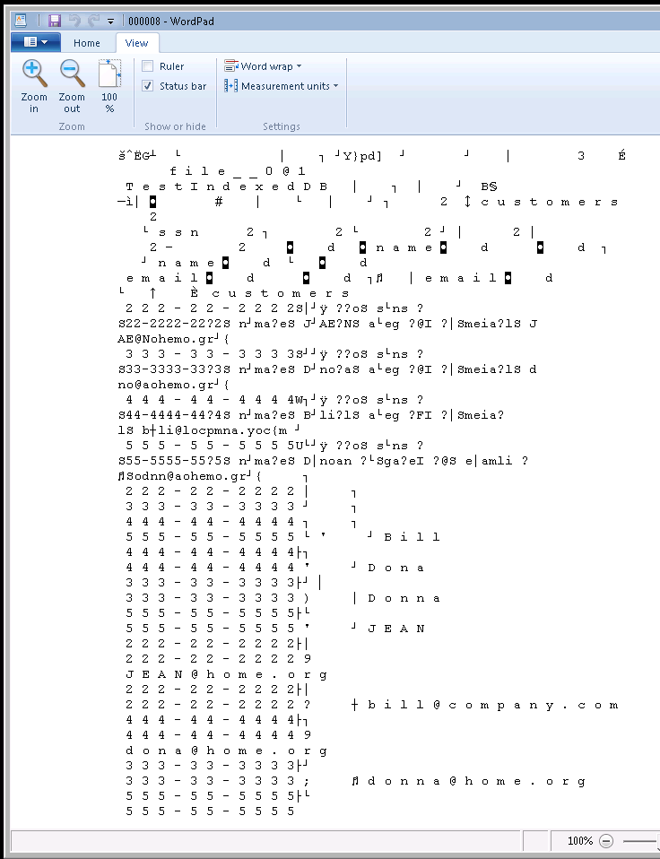
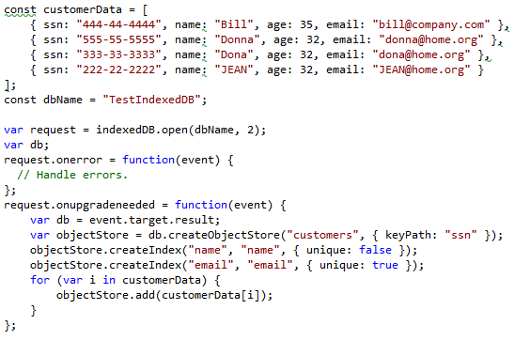
IndexedDB API
Key
11

Slide 14
Local Digital Safe
Notes:
14

Slide 15
Local Digital Safe
Decreasing the physical storage
maintained by the web site operator
Avoiding the loss of user’s data in case of vulnerability in web application
Replacing the proprietary solution such as Google Gears, LSO, etc.
HTML5 Local Storage APIs
Reducing the server load and improving the service scalability
Using Offline application when the device is disconnected
Lack of security in data storage as data are stored in clear
Lack of web application continuity across the user’s machine
Giving to the Local Storage the specification of the digital safe as it is defined by Afnor
Ensuring the synchronization between the Client Digital Safe and the Cloud Digital Safe
13

Slide 16
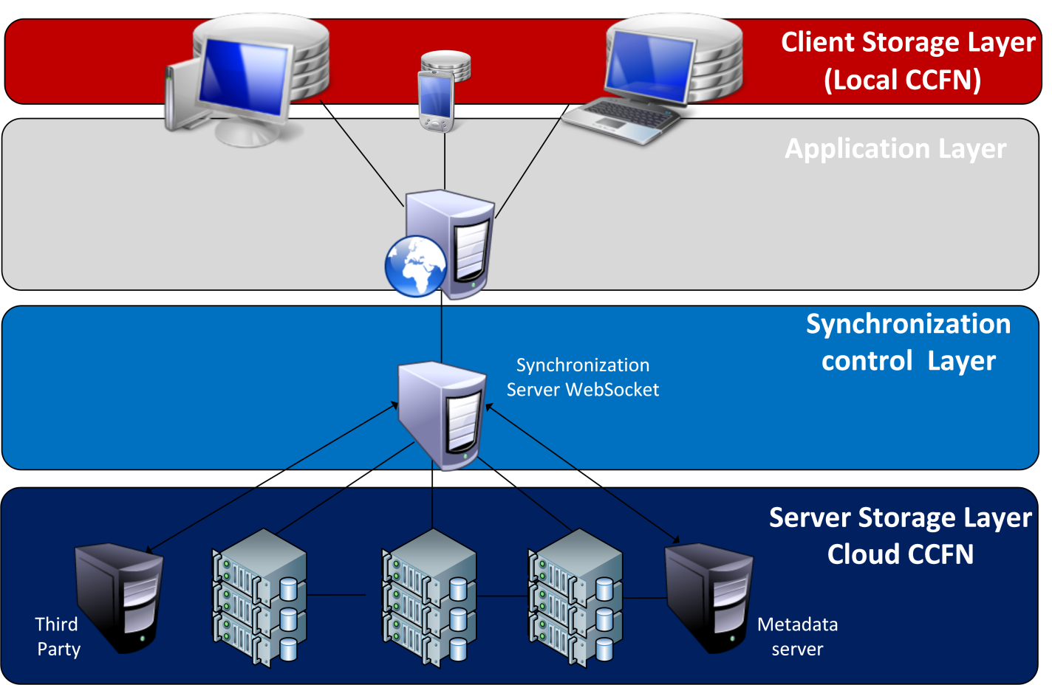
Local Digital Safe
Network Architecture
Local CCFN:
- Preserving a copy of the digital objects with their metadata in the user device (considering the offline cases)
Cloud CCFN
- Archiving digital information in the Cloud
- Ensuring their integrity over the long time
- Storing ON and their metadata in the Cloud
Metadata server:
- Storing information about files stored in the digital safe
Sychronization server:
- handling the different synchronization request and response
- Handling conflict resolution
- Interact with the blocks stored in the Digital Safe
Metada Server:
- Storing the metadata of each file
- Handling the access control
Third Party
- Prove the data archiving
14

Slide 17
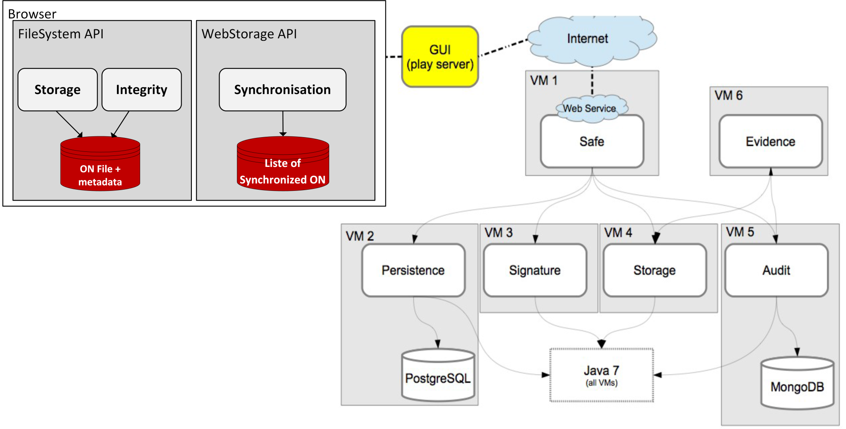
Local Digital Safe
Deployment Architecture
[1]
[1]: L113_gsafe_Dossier-Architecture-et-des-technologies
14

Slide 18
Standardization on FileSystem APIs
NF Z42-020 on FileSystem APIs
 | Standard NF Z42-020 | Specification of the FileSystem API with NF Z42020
Drop | Put the ON into the CCFN | - dirEntry.getDirectory(path, {create:true}, opt_successCallback, opt_errorCallback); - fileEntry.createWriter(successCallback, opt_errorCallback);
Read | Get a copy of the ON already stored in the CCFN | -fileEntry.file(successCallback, opt_errorCallback);
Read Metadata | Get the metadata of the ON already stored in the CCFN | fileEntry.GetXMLMetadata
Control | Verify the integrity of the ON already stored in the CCFN | fileEntry.VerifyIntegrity
Read log | Get all the traces of an ON | fileEntry.GetLog
List | Get a list of unique identifier of each ON | - fileEntry.getMetadata
Count | Get the total number of ON stored in the CCFN | - fileEntry.getMetadata
15

Slide 19
Considered modifications
In the browser
Adding the new specifications (GetIntegrity, VerifyIntegrity, GetLog) into the FileSystem API
Implementing the metadata of each ON
Securing the data stored by the HTML5 Local storage API
Encrypting the titles of the files that manage the storage of the different storage APIs to avoid metadata tampering
16

Slide 20
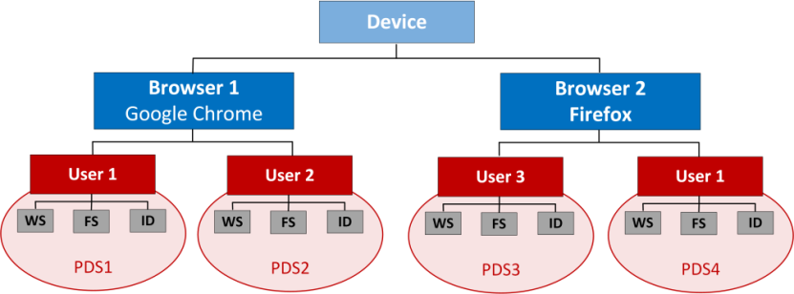
Work carried on WebStorage API
Securing data of WebStorage API
User integration in the management of local storage
Direved Key= PBKDF2 (SMP, Salt, C, dklength)
Where:
SMP: Single Master Password
Salt: The salt used for the derivation. This value must be
generated randomly
C: Number of intern iteration for the derivation
dkLen: Derivation Key length
PBKDF2 to encrypt APIs data
Ensure the data integrity
Ensure the metadata integrity
17

Slide 21
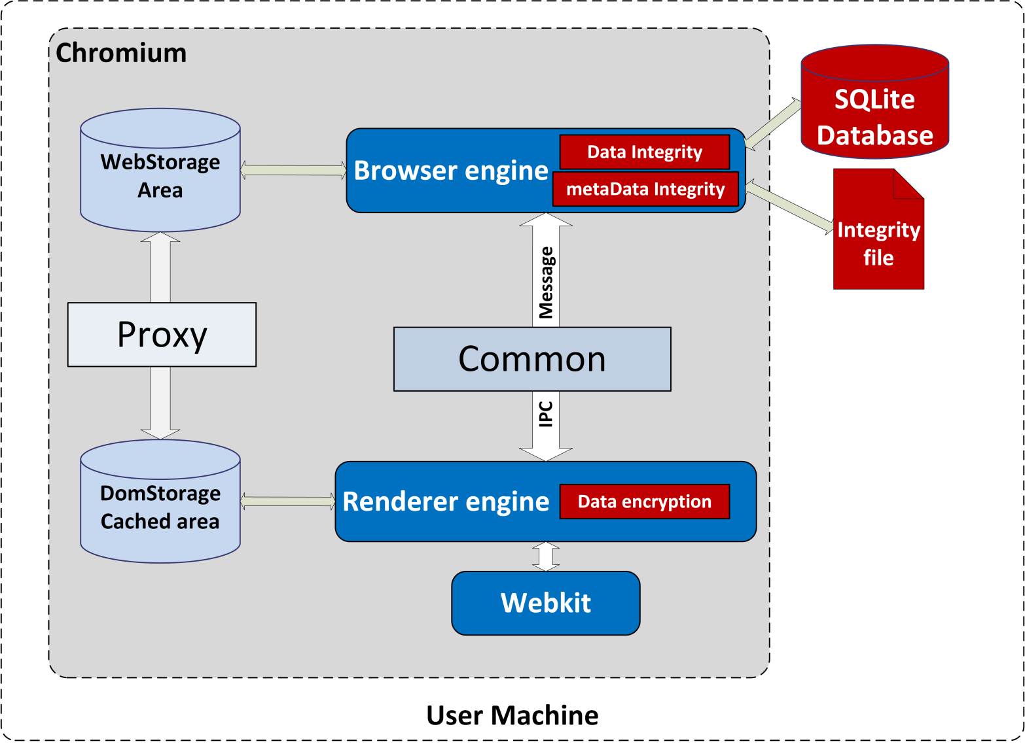
Implementation in Chromium
Chromium’s DomStorage Architecture with the HTML5 data protection
18

Slide 22
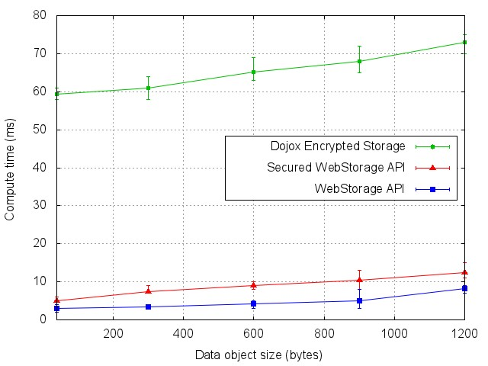
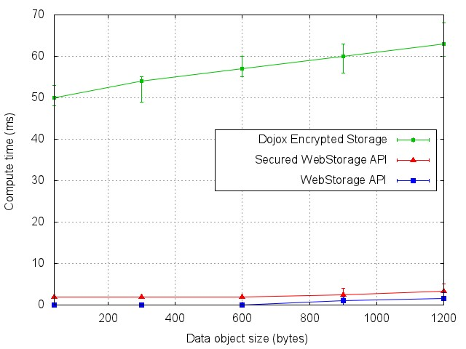
Implementation in chromium
Performance evaluation for the SetItem operation
Performance evaluation for the GetItem operation
Ensuring the confidentiality and integrity of data stored by the HTML5 WebStorage API comes at a cost
Performance degradation is lower when compared with the encryption of Dojox Storage Toolkit
Faced with the great data protection interest, the minor performance degradation can be tolerable
19

Slide 23
Conclusion
Notes:
23

Slide 24
Conclusion
We presented the HTML5 in general and the interest of the different HTML5 Local Storage APIs
We proposed a Digital Safe client based on the HTML5 Local Storage APIs
The Storage Client has the specification the Digital safe
On going extension to this proposition includes a synchronization algorithm that takes into consideration the Digital Safe standards
20

Slide 25
Thank you
Notes:
25

